Slide 1

June 11, 2025

Slide 2
Item 7: Final Workplan and Budget for Fiscal Year 2025-2026
Changes from the Proposed Budget to the Final Budget
1. Revised OPEB costs from Placer County, decreased costs from $158.19 per employee (E) per pay period (PP to $38.12/E/PP - reduction of 76% or $3,122.00.
2. Underfill the vacant assistant executive officer classification with a senior analyst classification.
3. Staggered start dates for the two new positions (senior analyst and an analyst I position). The senior analyst starts at the beginning of October 1, 2025, and the Analyst I starts at the beginning of January 1, 2026.
Changes from the Proposed Workplan to the Final Workplan
1. Remove the Alta Fire Protection District Municipal Service Review, Sphere of Influence, and related reorganization proposal.

Slide 3
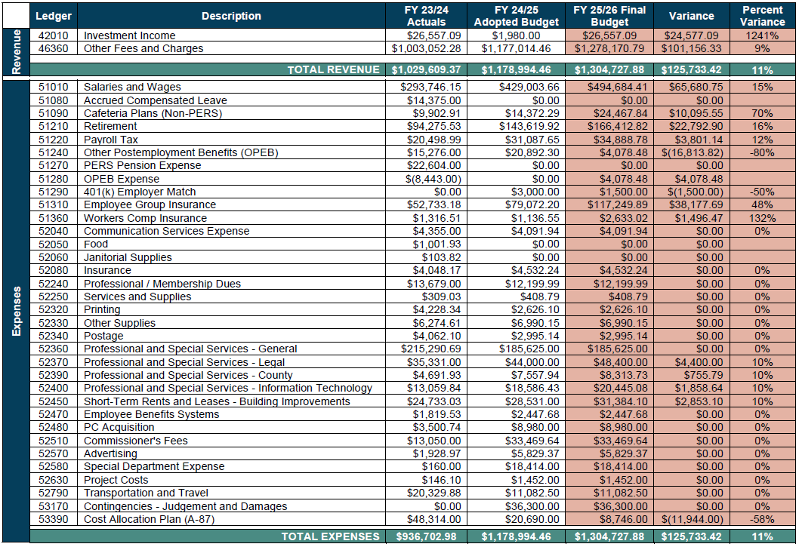
Proposed Final Budget – Staff Recommended

Slide 4
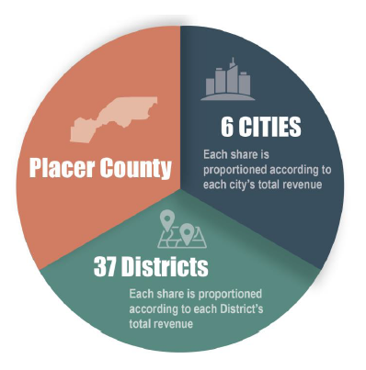
Proposed Invoice to Top 5 Funding Agencies
Agency | Prior Year Invoice | Proposed Invoice | Variance
Placer County | $392,338 | $427,514 | $35,176
City of Roseville | $286,149 | $318,529 | $32,380
PCWA | $134,898 | $138,048 | $3,151
City of Rocklin | $44,754 | $45,452 | $697
City of Lincoln | $45,263 | $45,189 | $(74)

Slide 5
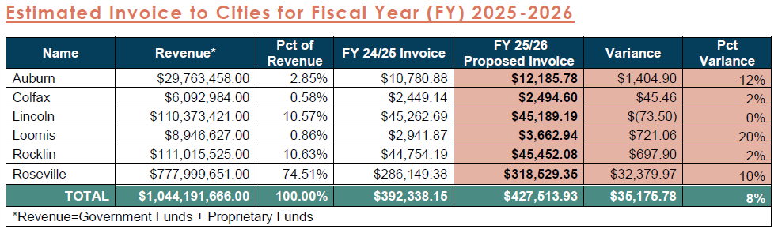

Slide 7
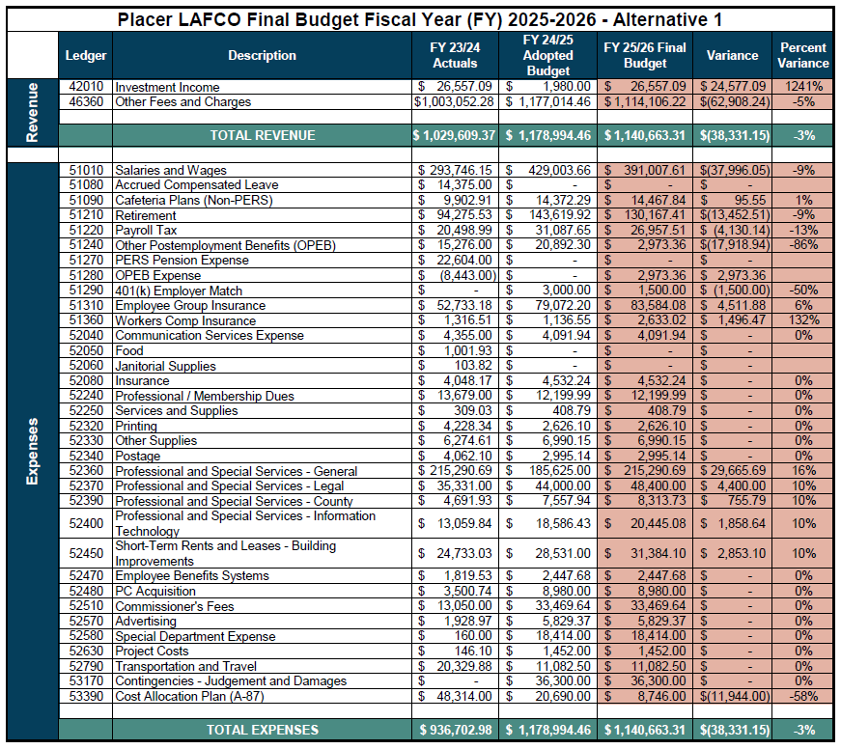
Alternative 1: Status Quo (3 FTE)

Slide 8
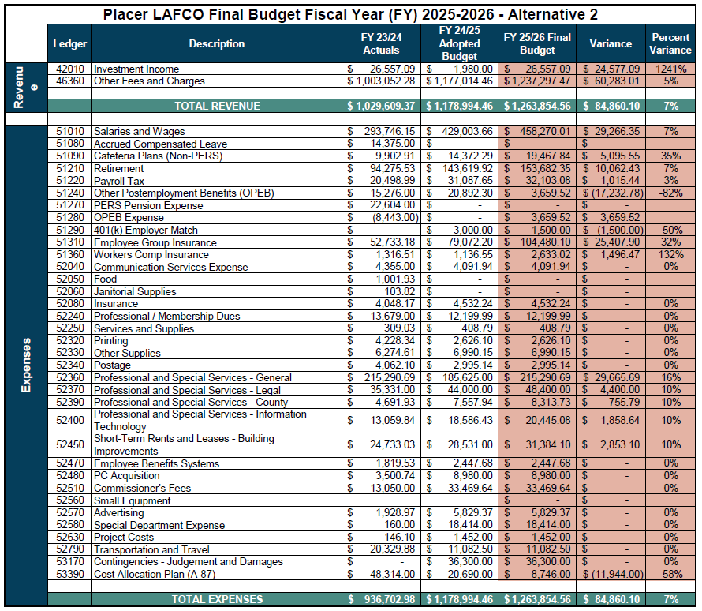
Alternative 2: 4 FTE

Slide 9
Item 7: Final Workplan and Budget for Fiscal Year 2025-2026
Staff Recommendation:
The Executive Officer recommends that the Commission adopt the staff-recommended Final Workplan and Budget for FY 2025-26 via adoption of Resolution 25-08 with any desired modifications and distribute it to LAFCO’s 44 funding agencies.
Procedures
1) Receive an oral report from the Executive Officer.
2) Open the hearing and invite comments from the public.
3) Consider the proposed Final Workplan and Budget.
4) Adopt or adopt with modifications the Final Workplan and Budget, as set forth in proposed Resolution No. 25-08 (Attachment B to this report), via a roll-call vote.
5) Direct staff to distribute the Final Workplan and Budget to the local funding agencies.

Slide 10
Upcoming Meeting Items – July 9, 2025
SUD-B NEQ Remnant Parcels Annexation to Lincoln
CSA 28 Boundary Overlaps

