Slide 1

July 9, 2025

Slide 2
Placer LAFCO Has a new Website!
https://www.placerlafcoca.gov/

Slide 3


Slide 4
Item 7: LAFCO Project No. 2023-02 SUD-B-NEQ Remnant Parcels Annexation to the City of Lincoln
Summary
This project proposes to annex approximately 25.5 acres of unincorporated territory to the City of Lincoln and concurrently detach the territory from the Placer County County Service Area 28.
Approval of this annexation will fulfill the Commission’s condition of approval of the Special Use District-Area B Northeast Quadrant (SUD-B NEQ) annexation as part of LAFCO Resolution No. 23-02. No development is proposed with this annexation.

Slide 5
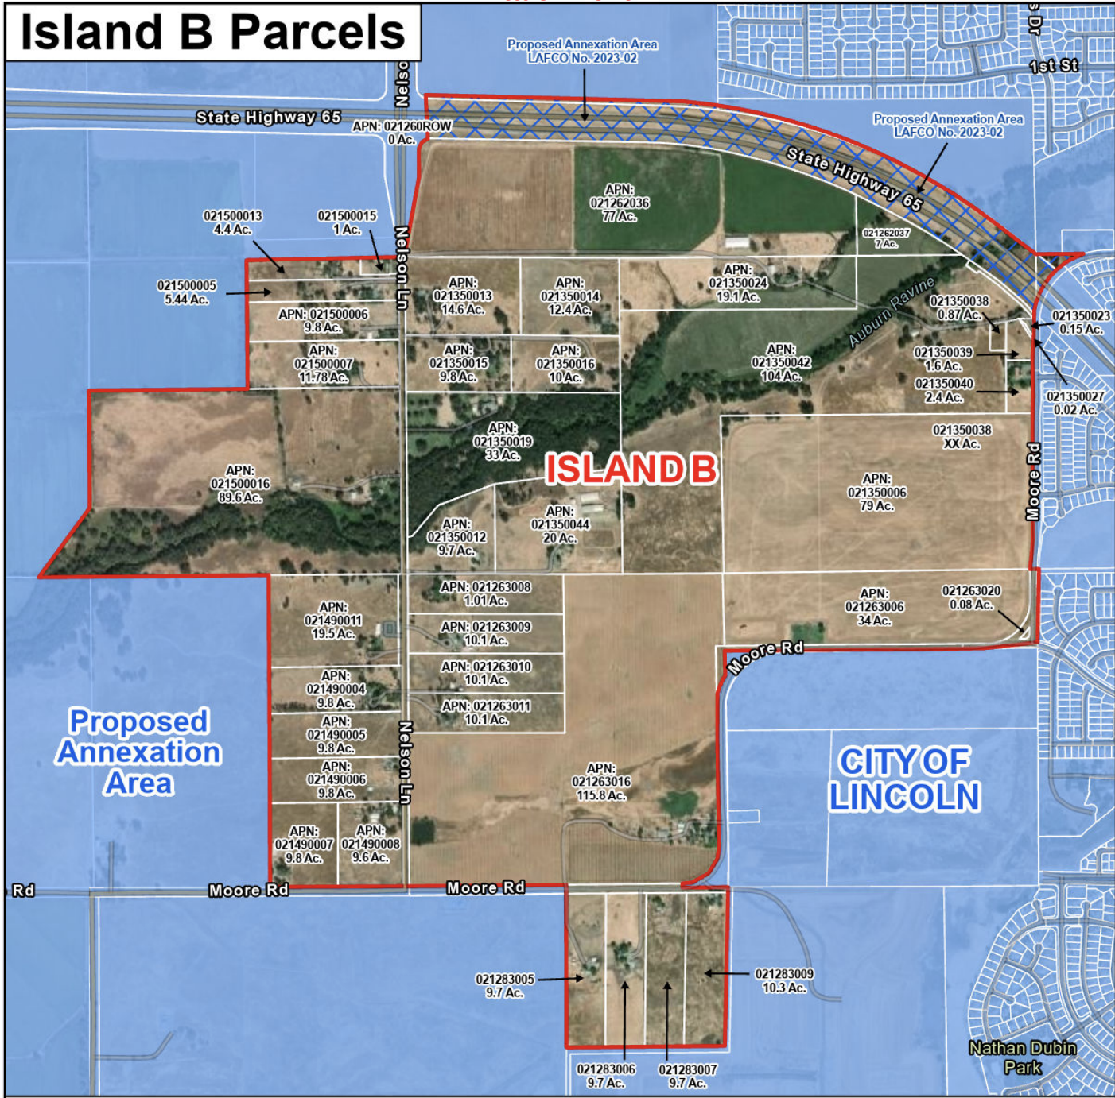
Item 7: LAFCO Project No. 2023-02
Village 5A Island B Parcels Map
Notes:
Village 5A annexation to the City of Lincoln – LAFCO Project No. 2024-02
Approved on December 4, 2024.

Slide 6
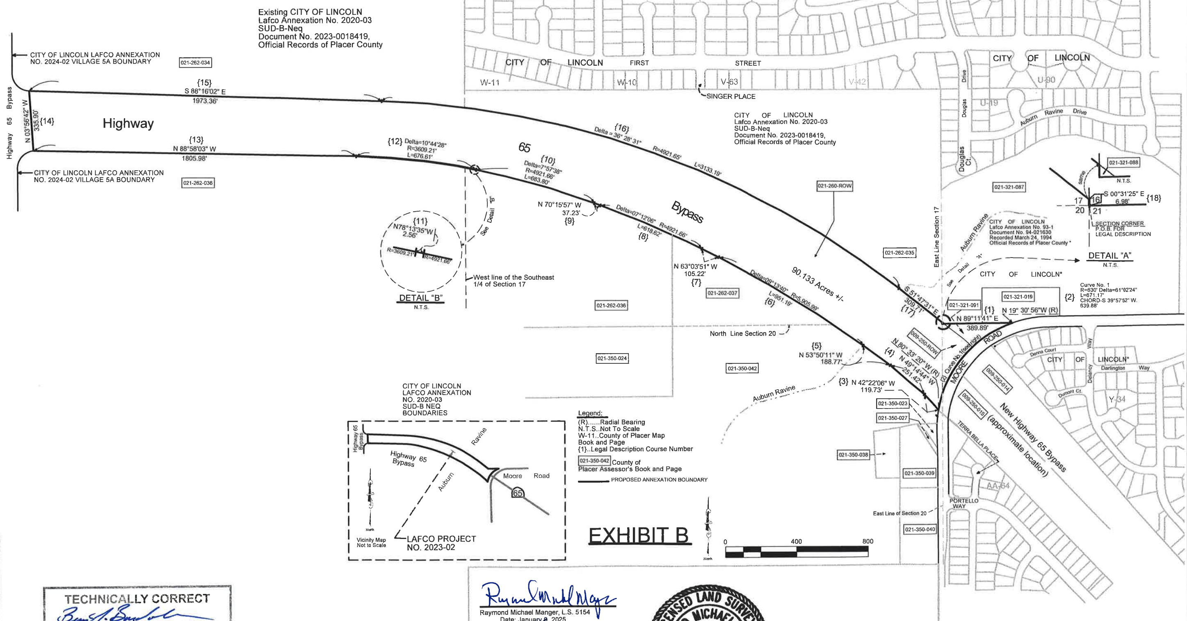
Item 7: LAFCO Project No. 2023-02
Attachment A – Exhibit 1

Slide 7
Item 7: LAFCO Project No. 2023-02
Conducting Authority Proceedings (Protest Hearing)
Option to Waive Protest Hearing
Pursuant to GC section 56663, any owner of land within the affected territory or any registered voter residing within the affected territory may submit written opposition to the proposal at any time before the conclusion of the public hearing on the proposal.
Staff have received two comment letters in opposition to this annexation (Attachment H).
No written opposition has been received from a landowner or registered voter residing within the affected territory as of the start of this hearing.

Slide 8
Item 7: LAFCO Project No. 2023-02
Staff Recommendation:
The Executive Officer recommends that the Commission adopt the proposed change of organization via the adoption of the proposed LAFCO Resolution No. 25-09 and waive the conducting authority proceedings (protest hearing).
Alternative for Consideration
Continue the item and request additional information from staff as needed.
Procedures
1) Receive an oral report from staff.
2) Open the hearing and invite comments from the public.
3) Consider the proposed LAFCO Project No. 2023-02
4) Adopt or adopt with modifications Resolution No. 25-09.
5) Direct staff to file the Notice of Exemption (NOE) as the responsible agency and sign the Certificate of Completion once all conditions of approval have been met.
Notes:
30-day reconsideration and 35-day challenge period for CEQA

